Slide 1
Advanced Prompt Engineering &
Optimization (Theory)
Dr. Koustav Rudra
Assistant Professor
Department of Artificial Intelligence
IIT Kharagpur
krudra@ai.iitkgp.ac.in
© 2026 IITKGP AI4ICPS I Hub Foundation. All rights reserved.

Slide 2
What is a Prompt ?
Prompt is initial text inputs given to a model, which it uses to generate responses or accomplish tasks
A prompt serves as an interaction point between a user and an LLM, allowing the model to generate specific outputs based on the input provided
It can take various forms, including questions, commands, text snippets, or even code, and can range from single words to complex paragraphs
Classify the following sentence on basis of Positive or negative sentiment :
Sentence : What a beautiful day
What is a Language Model ?
Write me a story about full moon
A question
A command
A prompt with text snippet

Slide 3

What is a Prompt ?
Write a python function that takes two numbers as input, and returns sum of the two numbers
”””def factorial(n):
if n == 0:
return 1
else:
return n * factorial(n - 1)””” : Convert this to C++`
Code Generation
Code Conversion
For LLMs, we can generally define two types : system prompts i.e. providing clear guidelines for the model on how to respond to user inputs, user prompts i.e. inputs by end-users to interact with the AI system and obtain desired outputs
The effectiveness of a prompt directly influences the relevance and accuracy of the model's response. Well-structured prompts help the model understand the user's intent better

Slide 4
What is Prompt Engineering ?
Directing LLM’s responses toward specific outcomes without altering the model’s weights or parameters
Goal : To refine the prompts to enhance the model’s accuracy and relevance in its outputs for the specified tasks
Can applied across a spectrum of tasks : Question-Answering, Arithmetic reasoning, Classification, Summarization, Personalization, Evaluation, etc.
Prompt: What are the benefits of exercise?
Response: Exercise improves physical health, boosts mental well-being, and enhances overall quality of life.
Prompt: If Jennifer bought 40 cans of milk and then 6 additional cans for every 5 cans Mark bought, how many cans did she buy if Mark purchased 50 cans?
Response: Jennifer bought a total of 40 + (6 * (50/5)) = 40 + 60 = 100 cans.
Prompt: Classify the following text: 'The weather today is sunny and warm.' Topics: ['News', 'Sports', 'Weather', 'Entertainment']
Response: "Topic: Weather"
Question Answering
Arithmetic Reasoning
Classification

Slide 5
What is Prompt Engineering ?
Prompt: Summarize the following text: 'The quick brown fox jumps over the lazy dog.'
Response: A fox jumps over a dog.
Prompt: Recommend a new book for a mystery lover.
Response: I recommend 'The Silent Patient' by Alex Michaelides.
Prompt: Evaluate the sentiment of the following review: 'This product exceeded my expectations!'
Response: Positive sentiment
Summarization
Personalisation
Evaluation
The ‘engineering’ term in Prompt Engineering is used as it involves systematic prompt design process, optimised for the tasks at hand that is achieved through iterative refinement
Carefully crafted prompts help to understand users’ intent better

Slide 6
Common LLM Inference terms

Slide 7

Terms required when interacting to an LLM
Tokens : They are the basic units of text that LLMs process. They can represent words, subwords, or characters, depending on the tokenizer used
This prompt engineering course is offered by AI4ICPS. Let's learn about the tokenizer and tokens
This
prompt
engineering
course
is
offered
by
AI
4
IC
PS
.
Let
‘
s
learn
about
the
token
izer
and
tokens
Subword Tokenization :
Goal: Represent text efficiently while handling both common and rare words.
Principle:
Frequent words remain whole (e.g., "engineering").
Rare words are split into meaningful subwords (e.g., "tokenizer" becomes "token" and "izer").
Tool : https://lunary.ai/mistral-tokenizer
Tokenization | Mistral AI Large Language Models

Slide 8

Terms required when interacting to an LLM
from transformers import AutoModelForCausalLM, AutoTokenizer
tokenizer = AutoTokenizer.from_pretrained("mistralai/Mistral-7B-Instruct-v0.1")
input = "This prompt engineering course is offered by AI4ICPS. Let's learn about the tokenizer and tokens"
# Tokenizing the prompt
model_inputs = tokenizer([input], return_tensors="pt")
# Fetching the ids
input_ids = model_inputs['input_ids'][0]
# Decoding the input IDs to get the tokens
tokens = tokenizer.convert_ids_to_tokens(input_ids)
# Printing the tokens and their corresponding IDs
for token_id, token in zip(input_ids.tolist(), tokens):
print(f"Token ID: {token_id}, Token: {token}")
Output
Token ID: 1, Token: <s>
Token ID: 851, Token: ▁This
Token ID: 11510, Token: ▁prompt
Token ID: 13320, Token: ▁engineering
Token ID: 2363, Token: ▁course
Token ID: 349, Token: ▁is
Token ID: 6373, Token: ▁offered
Token ID: 486, Token: ▁by
Token ID: 16107, Token: ▁AI
Token ID: 28781, Token: 4
Token ID: 1604, Token: IC
Token ID: 5412, Token: PS
Token ID: 28723, Token: .
Token ID: 3169, Token: ▁Let
Token ID: 28742, Token: '
Token ID: 28713, Token: s
Token ID: 2822, Token: ▁learn
Token ID: 684, Token: ▁about
Token ID: 272, Token: ▁the
Token ID: 6029, Token: ▁token
Token ID: 4024, Token: izer
Token ID: 304, Token: ▁and
Token ID: 16246, Token: ▁tokens
Input: Mistral 7B Instruct takes Token IDs (numerical representations of tokens) as input.
Output: Based on these Token IDs, the model calculates and outputs the most likely sequence of next tokens during inference.

Slide 9
Terms required when interacting to an LLM
Temperature : It controls the randomness of predictions made by the model. A lower temperature (e.g., 0.0) results in more deterministic outputs, while a higher temperature (e.g., 1.0) increases randomness and creativity in responses.
Use Cases
Low Temperature
Close to 0
• High Reasoning
• Low Creativity
• Predictable Output
• Conservative Responses
High Temperature
Close to 1
• Low Reasoning
• High Creativity
• Diverse Output
• Unexpected Responses
Low Temperature
• Translations
• Generating Factual Content
• Answering specific questions
High Temperature
• Creative Writing
• Brainstorming ideas
• Generating diverse responses
Temperature in Action
Creative Task
"Generate a unique superhero concept"
Temperature 0:
Identical ideas:
"Superman-like character with flight and super strength"
Temperature 1:
Diverse ideas:
"A plant-based hero who can manipulate vines and communicate with trees"
Logical Task
"Explain the process of photosynthesis"
Temperature 0:
Consistent, textbook-like explanation of photosynthesis
Temperature 1:
Varied explanations, potentially wrong, tend to hallucinate

Slide 10
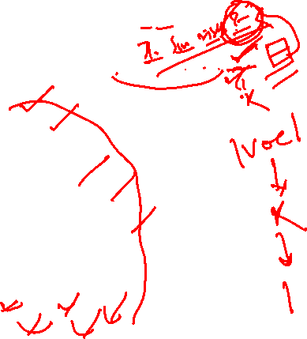
Terms required when interacting to an LLM
Top_k : Top-K sampling involves selecting the top K most likely words from the probability distribution and then sampling the next word only from this subset
The sun rises in the ___ … … … …
Candidate tokens
0.19
For example, Imagine a scenario where an LLM is prompted with “The sun rises in the”.
0.17
sample
k = 5
Likelihood
0.15
The model might assign the highest probabilities to words like "east", "morning", "sky", etc
0.14
{
Clipped tail
0.1
With Top-K sampling where K=5, the model would only consider the top 5 words with the highest probability for its next output.
planet
east
sky
glow
down
morning
distance
space
vastness
This method reduces the chances of generating highly improbable words and provides a more controlled and predictable output.

Slide 11

Terms required when interacting to an LLM
The sun rises in the ___ … … … …
Top_p / Nucleus Sampling : Instead of selecting a fixed number of top words, the model selects a subset of words that have a cumulative probability exceeding a certain threshold P.
Candidate tokens
0.19
top-p = 0.65
0.17
sample
For example, Consider the same scenario where an LLM is prompted with “The sun rises in the” and top-p = 0.65
Likelihood
0.15
{
Clipped tail
0.14
If the top 4 words in the probability distribution cumulatively account for 65% of the probability mass and we set P=0.65, then the model would sample the next word from this set of 4 words
0.1
planet
east
sky
glow
down
morning
distance
space
Top-p is more dynamic than Top-K, adapting the subset size based on the probability distribution
vastness
It can capture more diversity in outputs, reducing repetitiveness

Slide 12
About Mistral

Slide 13


Mistral Models
Research Models
Premier models
Legacy Models
Mathstral [7B]
Mistral Large [123B]
Mistral 7B [7B]
Codestral Mamba [7B]
Mistral Small [22.2B]
Mixtral 8x7B [46.7B]
Mistral Nemo [12B]
Codestral [22B]
Mixtral 8x22B [141B]
Mistral Embed [API access]
Models | Mistral AI Large Language Models

Slide 14

Millions of Task-specific examples
Pretrained base model
Instruction fine-tuned Model
Fine-tuned on
results in
{ "instruction": "Describe the structure of an atom.",
"input": "",
"output": "An atom is made up of a nucleus, which contains protons and neutrons, surrounded by electrons that travel in orbits around the nucleus. The protons and neutrons have a positive charge, while the electrons have a negative charge, resulting in an overall neutral atom. The number of each particle determines the atomic number and the type of atom."}
{"instruction": "Identify the odd one out.",
"input": "Twitter, Instagram, Telegram",
"output": "Telegram"},
{ "instruction": "Classify the following into animals, plants, and minerals",
"input": "Oak tree, copper ore, elephant",
"output": "Oak tree: Plant\n Copper ore: Mineral\n Elephant: Animal"},
{ "instruction": "Use the given data to calculate the median.",
"input": "[2, 3, 7, 8, 10]",
"output": "The median of the given data is 7." },
{"instruction": "Paraphrase the following sentence",
"input": "The scientists conducted a rigorous experiment",
"output": "The scientists ran a thorough experiment."},
…….
Objective : To improve the models' ability to understand (generalization) and follow user instructions effectively.
raw.githubusercontent.com/tatsu-lab/stanford_alpaca/refs/heads/main/alpaca_data.json
https://github.com/zhilizju/Awesome-instruction-tuning?tab=readme-ov-file

Slide 15

Chat template for Mistral-7B-Instruct
It's important to note that to effectively prompt the Mistral 7B Instruct and get optimal outputs, it's recommended to use the following chat template :
<s>[INST] Instruction [/INST] Model answer</s>
The <s> and </s> are special tokens for beginning of string (BOS) and end of string (EOS) while [INST] and [/INST] are regular strings
The very first instruction should begin with a beginning of string (BOS) token, <s> . The next instructions should not. The assistant generation will be ended by the end-of-sentence token id.

Slide 16

What is System Prompt ?
from transformers import pipeline
messages = [
{"role": "system", "content": "You are a helpful medical assistant chatbot. You provide accurate and informative responses to medical questions"},
{"role": "user", "content": "What are the symptoms of the flu?"},
]
chatbot = pipeline("text-generation", model="mistralai/Mistral-7B-Instruct-v0.3")
response = chatbot(messages)
print(response[0]['generated_text'][-1]['content'])
Purpose: Provide initial instructions and context to guide the AI's behaviour before user input.
Provides :
Background information.
Desired role of the AI (e.g., helpful assistant, creative writer).
Specific instructions or constraints.
Goal: Ensure LLM’s responses are relevant, appropriate, and aligned with user expectations.
https://huggingface.co/mistralai/Mistral-7B-Instruct-v0.3

Slide 17
User Prompting Methods

Slide 18
Zero Shot Prompting

Slide 19

Zero Shot Prompting
User : Classify the test into neutral, negative or positive. Just give me the classification.
Text : I think the vacation is okay.
Sentiment :
Mistral : Neutral
Direct instructions: Users tell the AI what to do without providing specific examples.
Relies on pre-trained knowledge: LLMs learn to perform tasks from massive datasets, enabling them to generalize to new, unseen instruction
Versatile and adaptable: Zero-shot prompting makes AI models useful for a wide range of applications without task-specific fine-tuning.
https://arxiv.org/pdf/2109.01652
https://www.promptingguide.ai/techniques/zeroshot

Slide 20
Zero Shot Prompting
User : Solve the math problem: What is 3/7 of 84?
Mistral : To find 3/7 of 84, we can use the multiplication property of fractions: (3/7) * 84
First, let's multiply the numerators:
3 * 84 = 252
Next, multiply the denominators:
7 * 84 = 588
Now, multiply the products:
252 ÷ 588
To divide two numbers, we can use a calculator or long division:
252 ÷ 588 ≈ 0.428571428571
So, 3/7 of 84 is approximately 0.4286.
Model size matters: Larger LLMs (e.g., Mistral 123B) are better at zero-shot tasks than smaller models (e.g., Mistral 7B).
Complexity challenges: Zero-shot prompting can struggle with complex tasks where implicit knowledge or specific examples are needed.
Lack of context can lead to:
Vague or imprecise responses.
Difficulty in understanding nuanced instructions.
Solution: Providing examples (few-shot prompting) can significantly boost performance on challenging tasks.
WRONG
https://arxiv.org/pdf/2109.01652
https://www.promptingguide.ai/techniques/zeroshot

Slide 21
Few Shot Prompting

Slide 22

Few Shot Prompting
User : This is awesome // Positive
This is bad! // Negative
Wow that movie was rad! // Positive
What a horrible show! //
Mistral : Negative
Few-shot learning involves providing the model with a small number of high-quality examples that include both input and desired output for the target task.
Benefits : These examples help the model grasp:
User intent
Desired output format and style
Takeaway: Few-shot learning generally leads to more accurate and relevant responses compared to zero-shot prompting.

Slide 23

Few Shot Prompting
User : The odd numbers in this group add up to an even number: 4, 8, 9, 15, 12, 2, 1.
A: The answer is False.
The odd numbers in this group add up to an even number: 17, 10, 19, 4, 8, 12, 24.
A: The answer is True.
The odd numbers in this group add up to an even number: 16, 11, 14, 4, 8, 13, 24.
A: The answer is True.
The odd numbers in this group add up to an even number: 17, 9, 10, 12, 13, 4, 2.
A: The answer is False.
The odd numbers in this group add up to an even number: 15, 32, 5, 13, 82, 7, 1.
A:
Model : The answer is True
WRONG
When dealing with more complex reasoning tasks e.g. mathematical reasoning, this method may fail to deliver the correct output
For example: shown on the top, we can check that it is not the correct response : It seems like few-shot prompting is not enough to get reliable responses for this type of reasoning problem

Slide 24
Meta Prompting

Slide 25

Meta Prompting
Meta Prompt
Problem Statement:
• Problem: [question to be answered]
Solution Structure:
1. Begin the response with "Let’s think step by step."
2. Follow with the reasoning steps, ensuring the solution process is broken down clearly and logically.
3. End the solution with the final answer encapsulated in a LaTeX-formatted box, ... , for clarity and emphasis.
4. Finally, state "The answer is [final answer to the problem].", with the final answer presented in LaTeX notation
+
Few Shot prompt
Problem: Find the domain of the expression √(x−2 )/ √(5−x) .
Solution: The expressions inside each square root must be non-negative. Therefore, x − 2 ≥ 0, so x ≥ 2, and 5 − x ≥ 0, so x ≤ 5. Also, the denominator cannot be equal to zero, so 5 − x > 0, which gives x < 5. Therefore, the domain of the expression is [2, 5) . Final Answer: The final answer is [2, 5). I hope it is correct.
————————————————————————————————————————————————————
Problem: If det A = 2 and det B = 12, then find det(AB).
Answer by LLM
Let’s think step by step.
1. We know that the determinant of a product of matrices (AB) is equal to the product of their determinants (det A * det B). This is given by the formula: det(AB) = det A * det B.
2. We are given that det A = 2 and det B = 12.
3. Substitute these values into the formula: det(AB) = 2 * 12.
4. Calculate the product: det(AB) = 24.
So, the final answer is $\boxed{24}$.
2311.11482 (arxiv.org)

Slide 26
Meta Prompting
Meta prompting and few-shot prompting are different in that meta prompting focuses on a more structure-oriented approach as opposed to a content-driven approach which few-shot prompting emphasizes.
Abstract examples: Employs abstracted examples as frameworks, illustrating the structure of problems and solutions
The key characteristics of meta prompting are :
}
Structure-oriented: Prioritizes the format and pattern of problems and solutions over specific content.
Problem Statement:
• Problem: [question to be answered]
Solution Structure:
1. Begin the response with "Let’s think step by step."
2. Follow with the reasoning steps, ensuring the solution process is broken down clearly and logically.
3. End the solution with the final answer encapsulated in a LaTeX-formatted box, ... , for clarity and emphasis.
4. Finally, state "The answer is [final answer to the problem].", with the final answer presented in LaTeX notation
Syntax-focused: Uses syntax (e.g. $\boxed{}$.) as a guiding template for the expected response or solution.
Versatile: Applicable across various domains, capable of providing structured responses to a wide range of problems.
Meta Prompting, in its essence, prioritizes the format and pattern of problems and solutions, moving away from the specifics of content
Goal: Improve the LLM's ability to handle complex reasoning and cognitive tasks in a more systematic way.
2311.11482 (arxiv.org)

Slide 27
Chain-of-Thought Prompting

Slide 28

Chain of Thought Prompting
Few Shot
Few Shot CoT
Model Input
Model Input
Q. Roger has 5 tennis balls. He buys 2 more cans of tennis balls. Each can have 3 tennis balls. How many tennis balls does he have now?
A: The answer is 11
Q. The cafeteria had 23 apples. If they used 20 to make lunch and bought 6 more, how many apples do they have?
Q. Roger has 5 tennis balls. He buys 2 more cans of tennis balls. Each can have 3 tennis balls. How many tennis balls does he have now?
A : Roger started with 5 balls, 2 cans of 3 tennis balls each is 6 tennis balls. 5 + 6 = 11. The answer is 11
Q. The cafeteria had 23 apples. If they used 20 to make lunch and bought 6 more, how many apples do they have?
Model Output
Model Output
A : The answer is 27
The cafeteria had 23 apples originally. They used 20 to make lunch. So they had 23-20 = 3. They bought 6 more apples, so they have 3 + 6 = 9. The answer is 9
❌
✅
Technique: Guides the LLM to solve complex tasks by breaking them down into smaller, logical steps.
How it works: The prompt encourages the model to "think out loud" and show its reasoning process, leading to more accurate solutions.
Effectiveness: Especially powerful when combined with few-shot prompting, providing both examples and a structured approach.
[2201.11903] Chain-of-Thought Prompting Elicits Reasoning in Large Language Models (arxiv.org)
https://arxiv.org/abs/2205.11916
https://deepgram.com/learn/chain-of-thought-prompting-guide

Slide 29

Chain of Thought Prompting
User : The odd numbers in this group add up to an even number: 4, 8, 9, 15, 12, 2, 1.
A: Adding all the odd numbers (9, 15, 1) gives 25. The answer is False.
The odd numbers in this group add up to an even number: 17, 10, 19, 4, 8, 12, 24.
A: Adding all the odd numbers (17, 19) gives 36. The answer is True.
The odd numbers in this group add up to an even number: 16, 11, 14, 4, 8, 13, 24.
A: Adding all the odd numbers (11, 13) gives 24. The answer is True.
The odd numbers in this group add up to an even number: 17, 9, 10, 12, 13, 4, 2.
A: Adding all the odd numbers (17, 9, 13) gives 39. The answer is False.
The odd numbers in this group add up to an even number: 15, 32, 5, 13, 82, 7, 1.
A:
Mistral :The odd numbers in this group are: 15, 5, 13, 7, 1.
Adding these together gives: 15+5+13+7+1=41.
Since 41 is an odd number, the answer is False
✅
Model Size & Complexity: Larger LLMs are generally better at Chain-of-Thought reasoning.
CoT prompting can elicit correct answers to complex questions (as shown above), when few-shot prompting fails.
Key Takeaway: Sophisticated prompt engineering techniques like CoT can significantly enhance the reasoning capabilities of existing LLMs.
[2201.11903] Chain-of-Thought Prompting Elicits Reasoning in Large Language Models (arxiv.org)
https://arxiv.org/abs/2205.11916
https://deepgram.com/learn/chain-of-thought-prompting-guide

Slide 30
Variants of Chain of Thought Prompting

Slide 31

Variants of Chain of Thought Prompting
Zero-shot COT Prompting :
Zero Shot
Zero Shot CoT
Q. A juggler can juggle 16 balls. Half of the balls are golf balls, and half of the golf balls are blue. How many blue golf balls are there ?
A: The answer (arabic numerals) is
________________________________________
(Output) 8
Q. A juggler can juggle 16 balls. Half of the balls are golf balls, and half of the golf balls are blue. How many blue golf balls are there ?
A: Let’s think step by step
_________________________________________________
(Output) There are 16 balls in total. Half of the balls are golf balls. That means that there are 8 golf balls. Half of the golf balls are blue. That means that there are 4 blue golf balls
❌
✅
Simplifying CoT: No need to provide explicit reasoning steps in the prompt.
How it works:
Add "Let's think step by step" to the original prompt.
The LLM generates its own reasoning chain and uses it to arrive at the answer.
Benefits:
Task-agnostic: Applicable to a wide range of tasks without needing task-specific prompts.
Encourages deeper reasoning: Promotes more thoughtful and structured problem-solving by the LLM.
https://arxiv.org/abs/2205.11916

Slide 32

Variants of Chain of Thought Prompting
Automatic Chain-of-Thought (Auto-CoT)
Goal: Automate the creation of reasoning chains, reducing reliance on manually crafted examples.
Two-Stage Process:
Question Clustering: Questions from a dataset are grouped into clusters based on similarity. This helps in identifying representative questions for each cluster, ensuring diversity in the examples generated.
Q: While shopping for music online, Zoe bought 3 …
Clustering
..
..
k
1
Q: A chef needs to cook 9 potatoes. He has already…
https://github.com/amazon-science/auto-cot
https://arxiv.org/abs/2210.03493

Slide 33

Variants of Chain of Thought Prompting
Automatic Chain-of-Thought (Auto-CoT)
2. Demonstration Sampling:
2.a A representative question is chosen from each cluster.
Q: While shopping for music online … A: Let’s …
1
Q: While shopping for music online … A: Let’s …
Clustering
1
..
..
..
..
..
Sampling by Selection Criteria
1
k
LLM
Sampling by Selection Criteria
Q: A chef needs to cook 9 potatoes ... A: Let’s …
k
Q: A chef needs to cook 9 potatoes ... A: Let’s …
k
https://github.com/amazon-science/auto-cot
https://arxiv.org/abs/2210.03493

Slide 34
Variants of Chain of Thought Prompting
Automatic Chain-of-Thought (Auto-CoT)
Q: While shopping for music online, Zoe bought 3 country albums and 5 pop albums.
Each album came with a lyric sheet and had 3 songs.
How many songs did Zoe buy total?
A: Let’s think step by step. Zoe bought 3 country albums. Each album has 3 songs.
So she bought 3*3=9 songs from the country albums. Zoe bought 5 pop albums.
Each album has 3 songs. So she bought 5*3=15 songs from the pop albums.
Zoe bought 9+15=24 songs in total. The answer is 24. …
Q: A chef needs to cook 9 potatoes. He has already cooked 7.
If each potato takes 3 minutes to cook, how long will it take him to cook the rest?
A: Let’s think step by step. The chef has already cooked 7 potatoes.
That means it has taken him 7 * 3 minutes to cook those 7 potatoes.
That means it will take him 3 more minutes to cook each of the remaining 2 potatoes …
Q: A pet store had 64 puppies. In one day they sold 28 of them and put the rest into cages with 4 in each cage. How many cages did they use?
A: Let’s think step by step.
2.b Zero-Shot-CoT (with heuristics) generates a reasoning chain for the chosen question.
Q: While shopping for music online … A: Let’s …
1
Q: While shopping for music online … A: Let’s …
1
..
..
..
..
Sampling by Selection Criteria
Sampling by Selection Criteria
Q: A chef needs to cook 9 potatoes ... A: Let’s …
k
Q: A chef needs to cook 9 potatoes ... A: Let’s …
k
Outcome: Auto-CoT achieves comparable or superior performance to traditional CoT and few-shot prompting, especially for reasoning tasks.
Test Question
LLM
In-Context Reasoning
The pet store had 64 puppies. They sold 28 of them. That means they have 36 puppies left. They put the rest into cages with 4 in each cage. That means they have 9 cages. The answer is 9
https://github.com/amazon-science/auto-cot
https://arxiv.org/abs/2210.03493

Slide 35
ReAct

Slide 36
ReAct Prompting
ReAct is inspired by the synergies between “acting” and “reasoning” , the same way humans learn new tasks and make decisions or reasoning
It is a framework where LLMs are used to generate both reasoning traces and task-specific actions in an interleaved manner
Reasoning traces allow the model to induce, track, and update action plans, and even handle exceptions
Action step allows to interface with and gather information from external sources such as knowledge bases or environments
https://arxiv.org/abs/2210.03629

Slide 37

ReAct Prompting
Example
In the example (dynamic question answering), we pass a prompt like the following :
Aside from the Apple Remote, what other devices can control the program Apple Remote was originally designed to interact with?
ITERATION 1 :
ReAct (Reason + Act)
Thought 1: I need to search Apple Remote and find the program it was originally designed to interact with.
Act 1: Search [Apple Remote]
Obs 1: The Apple Remote is a remote control introduced in October 2005 by Apple _ originally designed to control the Front Row media center program _
Process:
Thought: LLM generates an initial thought based on the prompt (e.g., "Thought 1").
Act: The LLM takes an action, often using external tools to gather information (e.g., "Act 1: Search for Apple remote").
Observe: The LLM processes the results of its action and summarizes its findings ("Obs 1").
Iteration: The Thought-Act-Observe cycle repeats until the LLM arrives at a satisfactory answer.
Benefits: Enables LLMs to access and leverage external information, leading to more informed and reliable responses
https://www.youtube.com/watch?v=1c9iyoVIwDs
https://arxiv.org/abs/2210.03629

Slide 38

ReAct Prompting
ITERATION 2 :
ReAct (Reason + Act)
Thought 2: Apple Remote was originally designed to control the Front Row media center program. I need to search Front Row next and find what other device can control it.
Act 2: Search [Front Row]
Obs 2: Could not find (Front Row). Similar: ('Front Row Seat to Earth', 'Front Row Motorsports',' Front Row (software)', ...]
The free-form thoughts are used to achieve different tasks such as decomposing questions, extracting information, guide search formulation, and synthesizing final answer
ITERATION 3 & 4 :
ReAct (Reason + Act)
Thought 3: Front Row is not found. I need to search Front Row (software)
Act 3: Search [Front Row (software)]
Obs 3: Front Row is a discontinued media center software
Thought 4: Front Row (software) is controlled by an Apple Remote or the keyboard function keys. So the answer is keyboard function keys.
Act 4: Finish [keyboard function keys]
We can see that model generates task solving trajectories (Thought, Act)
The free-form thoughts are used to achieve different tasks such as decomposing questions, extracting information, guide search formulation, and synthesizing final answer
At Act step, the model can utilise search capabilities to search publicly about the corresponding thought
After getting the desired solution the process terminates at the subsequent Act (here Act 4) stage
https://www.youtube.com/watch?v=1c9iyoVIwDs
https://arxiv.org/abs/2210.03629

Slide 39
Directional Stimulus Prompting (DSP)

Slide 40
Directional Stimulus Prompting (DSP)
The framework introduces a new component called the “directional stimulus” into the prompt to provide nuanced, instance-specific guidance and control over LLMs.
The directional stimulus prompt acts as “hints” and “clues” for the input query to guide LLMs toward the desired output.
Notably, this differs from the methods that augment LLMs with additional knowledge retrieved from external sources, as the directional stimulus prompt is generated solely based on the input query in our framework.
A tuneable policy LM is trained to generate the hints that guide a black-box frozen LLM.
The approach incorporates keywords in the prompt as the directional stimulus prompt to hint at key points the desired summary should cover.

Slide 41


Directional Stimulus Prompting (DSP)
Step 1: Training a Policy Model that generates directional stimulus for LLMs
D` = {(x , z*)}
Supervised
Fine-tuning
Policy LM
Labeled Data
T5 / GPT-2
x
z*
Context: Article, Story, Document, etc.
Pseudo-stimulus: keywords of summary, dialogue acts, etc.
Example:
Article: Seoul (CNN) South Korea's Prime Minister Lee Wan-koo offered to resign on Monday amid a growing political scandal. Lee will stay in his official role until South Korean President Park Geun-hye accepts his resignation. He has transferred his role of chairing Cabinet meetings to the deputy prime minister for the time being, according to his office. ………………………………..CNN's Paula Hancocks contributed to this report.
Keywords: Lee Wan-koo; resign, South Korean tycoon; Sung Woan-jong; hanging from a tree; investigation; notes; top officials
Guiding Large Language Models via Directional Stimulus Prompting, NeurIPS 2023

Slide 42

Directional Stimulus Prompting (DSP)
Step 2: Training the Policy Model with RL
Reward (Rouge Score)
Policy LM
Context: Article, Story, Document, etc.
Stimulus: keywords of summary, dialogue acts, etc.
T5 / GPT-2
Output: Summary
Guiding Large Language Models via Directional Stimulus Prompting, NeurIPS 2023

Slide 43
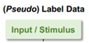
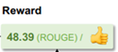

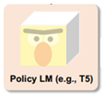
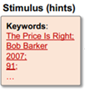
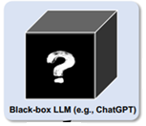
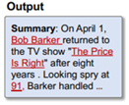
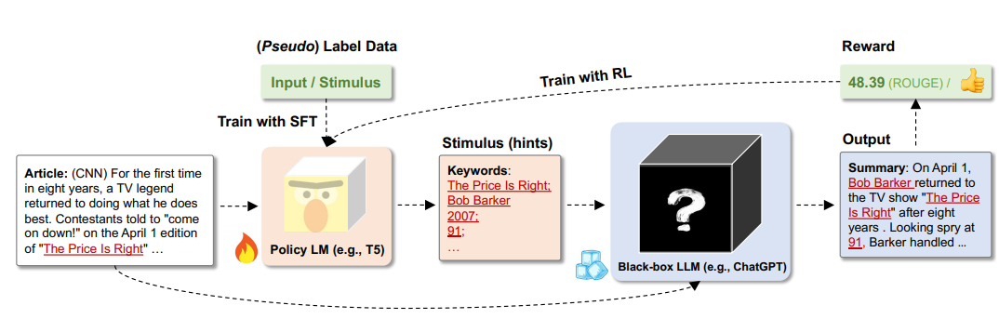
Directional Stimulus Prompting (DSP)
Workflow:
Guiding Large Language Models via Directional Stimulus Prompting, NeurIPS 2023

Slide 44
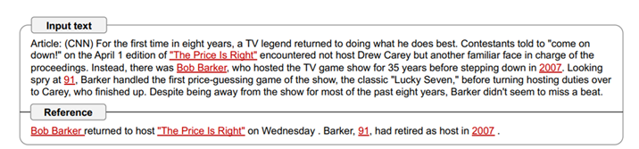
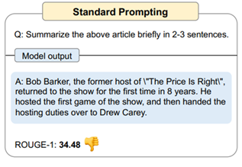
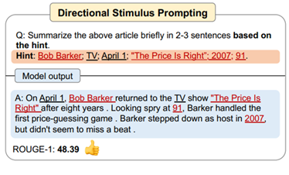
Directional Stimulus Prompting (DSP)
Guiding Large Language Models via Directional Stimulus Prompting, NeurIPS 2023

Slide 45
RAG

Slide 46
Retrieval Augmented Generation
Indexing
Retrieval
Generation
Basic RAG Workflow
Motivation: LLMs can benefit from access to external knowledge sources for factual accuracy and reliability.
How (Basic) RAG Works:
Input: User provides a query.
Retrieval: Relevant documents are retrieved from a knowledge source (e.g., Wikipedia).
Generation: The LLM uses the retrieved information to generate a response.
Benefits:
Factual Consistency: Improves the accuracy of generated content.
Up-to-Date Information: Allows LLMs to access current information beyond their training data.
https://arxiv.org/pdf/2404.10981https://ai.meta.com/blog/retrieval-augmented-generation-streamlining-the-creation-of-intelligent-natural-language-processing-models/

Slide 47
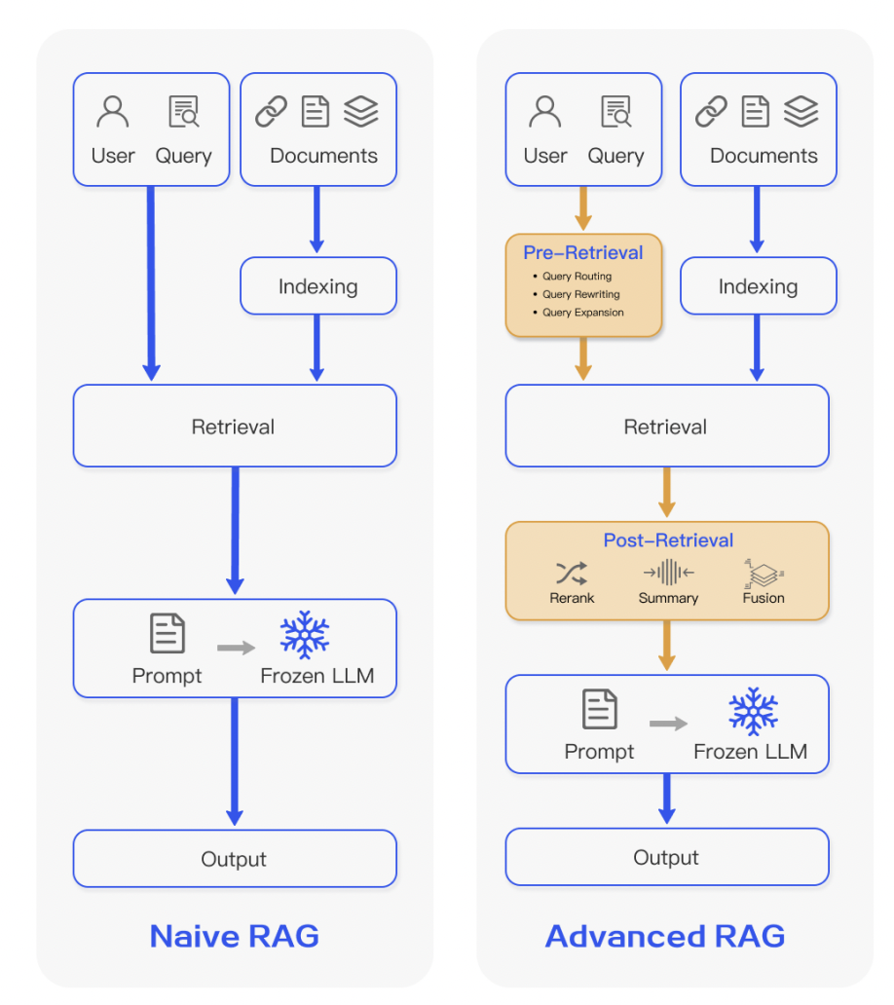


Retrieval Augmented Generation
Problem: LLMs can struggle with factual accuracy and limited pretrained information.
Solution: Give LLMs access to external knowledge sources.
RAG Approach:
User asks a question.
System finds relevant documents
LLM uses these documents to generate an accurate and reliable answer.
Benefits:
More factual responses.
Access to up-to-date information.
Indexing
Pre-Retrieval
1. Query Manipulation
Indexing
Retrieval
Retrieval
Post-Retrieval
1. Reranking
2. Filtering
Output
Output
Naive RAG
Advanced RAG

Slide 48
Retrieval Augmented Generation
RAG Paradigm
Pre-Retrieval
Retrieval
Post Retrieval
Generation
Indexing
Re-Ranking
Enhancing
Search Ranking
Customization
Query Manipulation
Generation Step: Retrieved documents are combined with the user's query and fed to the LLM.
Dynamic Knowledge: RAG allows LLMs to access the most up-to-date information, overcoming the limitations of their static internal knowledge.
Benefits:
Adaptability: Handles evolving facts and information.
Efficiency: No need to constantly retrain the LLM for new knowledge.
Reliability: Generates more accurate and trustworthy outputs.
https://ai.meta.com/blog/retrieval-augmented-generation-streamlining-the-creation-of-intelligent-natural-language-processing-models/

Slide 49
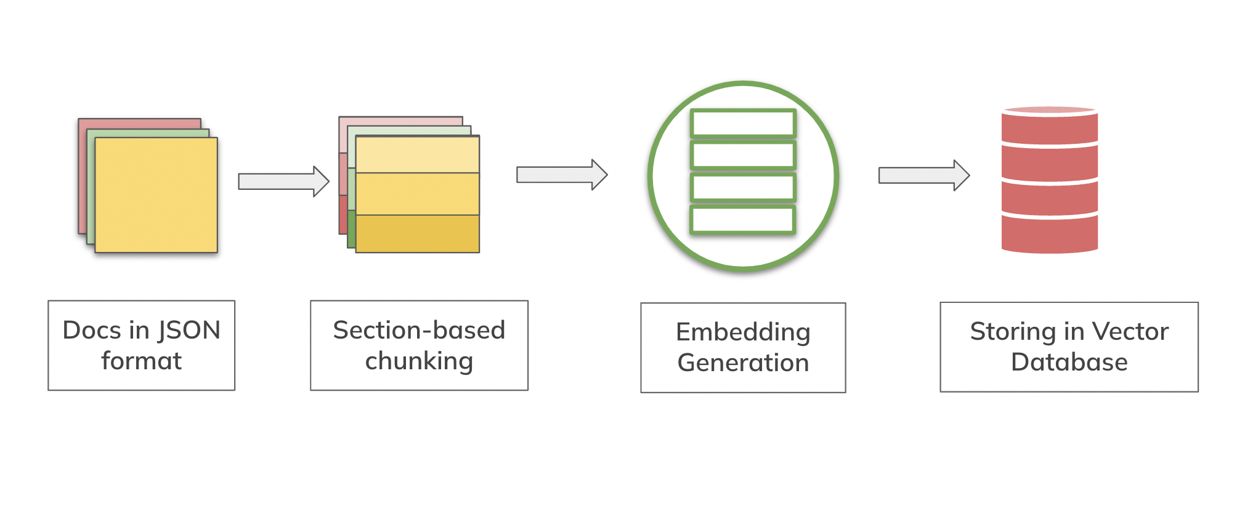
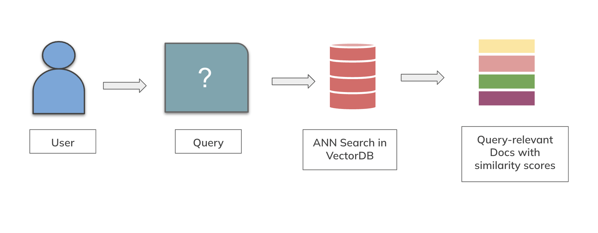
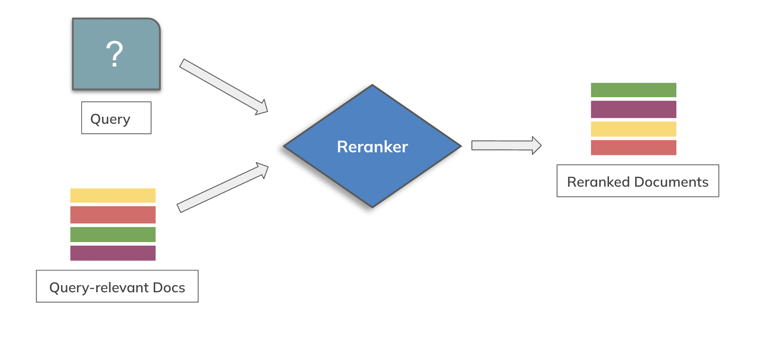
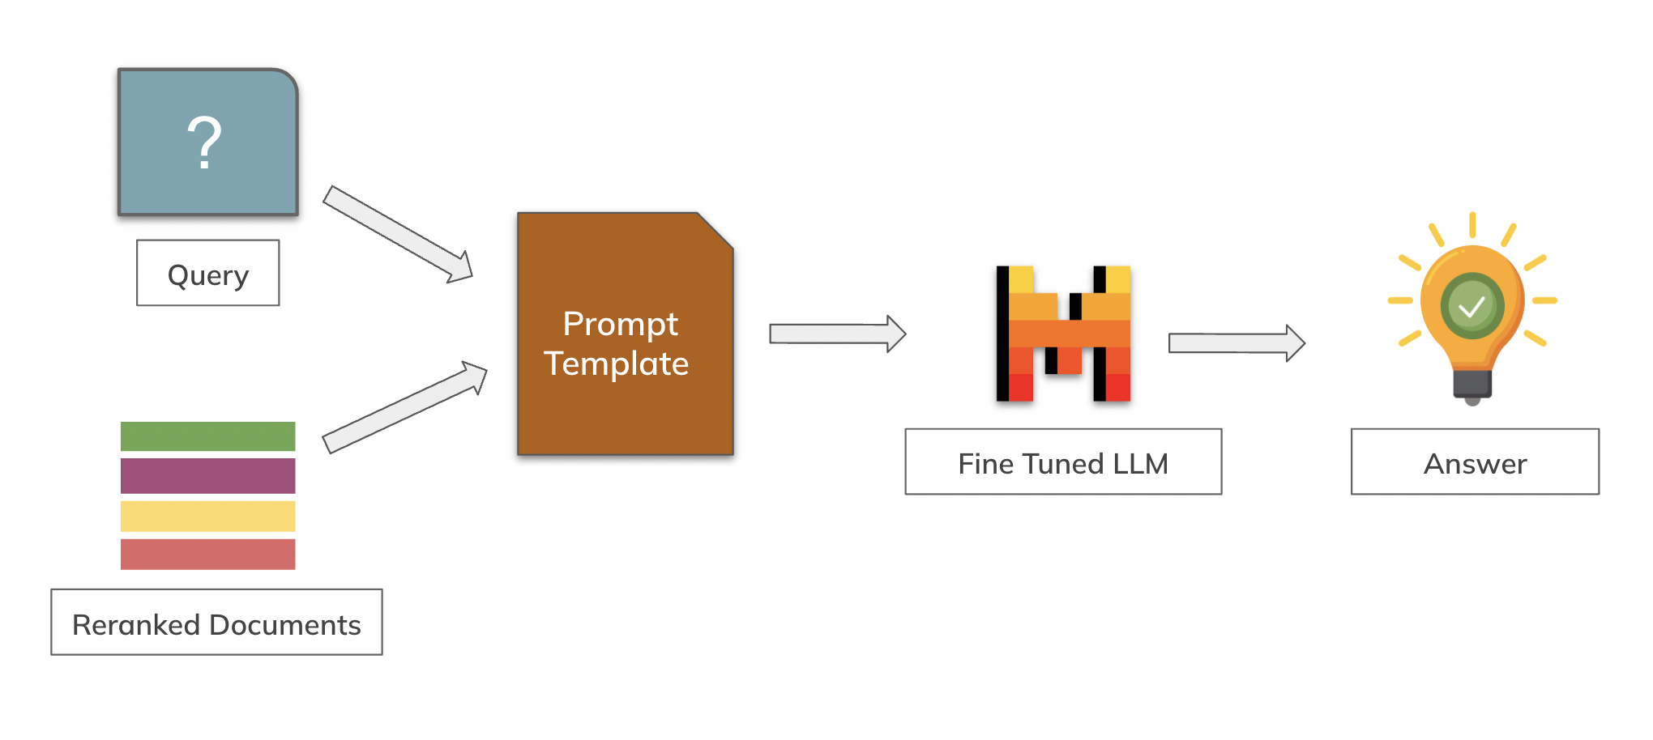
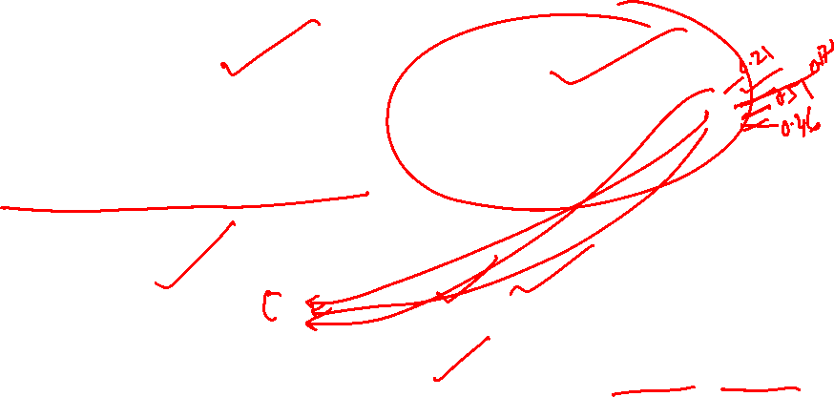
Retrieval Augmented Generation : An example
Pre-Retrieval
Retrieval
Post-Retrieval
Augmentation and Generation
https://ai.meta.com/blog/retrieval-augmented-generation-streamlining-the-creation-of-intelligent-natural-language-processing-models/

Slide 50
Retrieval

Slide 51
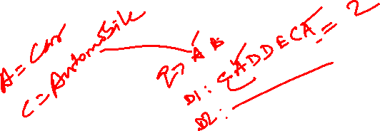
Sparse Retrieval
Sparse Retrieval in RAG: Keyword-Focused Search
Method: Matches documents based on shared keywords with the user's query.
Ranking: Uses algorithms like BM25 to score documents based on how often and how uniquely query terms appear.
Query
Document
[Sparse Vectors]
Top N most similar documents
Sparse Retriever
Retrieves most similar
Strengths: Fast and efficient, especially for large datasets.
Weakness: Limited understanding of meaning; might miss relevant documents that use different words.
Sparse retrieval methods are often more interpretable, as they provide clear reasoning based on term occurrences, making it easier to understand why certain documents were retrieved.

Slide 52
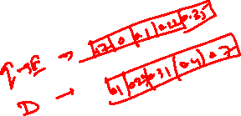
Dense Retrieval
Method: Uses deep learning (e.g., BERT, T5) to represent both queries and documents as vectors (embeddings) that capture semantic meaning.
Matching: Finds documents with similar meanings to the query, even if they don't share exact keywords.
Query
Embedding
Vector Database
Top N most similar documents
Embedding Model
Retrieves semantically similar documents
Strengths: More accurate and relevant retrieval, especially for complex or nuanced queries.
Weaknesses: Can be computationally more expensive than sparse methods.

Slide 53
Augmentation and Generation

Slide 54
Augmentation and Generation
Grounding : Grounding involves providing LLMs with use-case specific data and knowledge sources that are not inherently part of their original training data. RAG framework acts as grounding for LLMs
Other instructions
----------------------------------------------------------------------------------------------------
Prompt Template
LLM
Relevant retrieved context
Generated Response
Query
The LLM processes the input and generates a coherent and contextually appropriate response. This response leverages the external information retrieved in the augmentation step, allowing the model to provide more accurate and nuanced answers.

Slide 55
Function Calling

Slide 56
Function Calling
Function calling in LLMs refers to the ability of these models to reliably connect to external tools, APIs, and systems to extend their functionality and knowledge. Mistral-7B-Instruct-v0.3 supports function calling
There are four steps with function calling, let’s understand it through an example : Let’s say we wrote two functions for tracking payment status and payment date . We can use these two tools to provide answers for payment-related queries.
Step 1 : Specify tools and query
Payment Status
What’s the status of my payment?
My transaction ID is S4D001
User
Tools
User Query
Payment Date
Step 2 : Generate function arguments if applicable
Developer/Model
Generate Function Arguments
Tool_calls :
Function Name
Payment Status
Function Arguments
transaction _id = S4D001
Model’s Output
https://docs.mistral.ai/capabilities/function_calling/

Slide 57
Function Calling
3. Execute function to obtain tool results
Payment Status function executed with arg : transaction_id =S4D001
Developer
Payment Status
Execute
Function
“Paid”
Output = ‘Paid’
4. Output of the function along with previous context and query passed to the model : Model generates final answer
According to the information available, your transaction with ID S4D001 has been paid. Is there anything else I can assist you with ?
Model
Generate Final
Answer
Model’s Final Response
https://docs.mistral.ai/capabilities/function_calling/

Slide 58
Prompt Optimization

Slide 59
Prompt Engineering
Prompt Optimization
Design of a prompt structure from scratch
Using prompting techniques
Refinement and tuning of an existing or original prompt
To improve performance across multiple runs or datasets
Involves the strategic use of few-shot examples, formatting and metaprompts
Focuses on iterative testing, output evaluation and improvement by using evaluation metrics
https://www.ibm.com/think/topics/prompt-optimization

Slide 60
Why Prompt Optimization is necessary?
Helps to leverage the full potential of large language models (LLMs) across varied domains
Data-driven optimization can significantly enhance task performance and reliability—especially in contexts involving nuanced reasoning or domain-specific accuracy
Not only improve the quality of model outputs but also help for developing scalable and reproducible AI applications

Slide 61
Why Prompt Optimization is necessary?
Beyond output quality, optimization has measurable impacts on performance efficiency
Enhances relevance while minimizing unnecessary token usage
Translates directly to better resource utilization, lower latency and reduced API costs
From a reasoning perspective, prompt structure matters greatly
Foundational practice for generating accurate, efficient and aligned outputs from LLMs in real-world applications

Slide 62
Optimization Techniques (Basic)

Slide 63
Optimization Techniques
Be Specific and Direct
Prompt:
“Tell me about hepatomegaly”
Optimized Prompt:
“What are the three main causes of hepatomegaly and their specific impacts on digestive system?”
https://www.datacamp.com/blog/prompt-optimization-techniques

Slide 64

Optimization Techniques
Set Context
Idea
Providing relevant background information helps the AI understand the context of your request, leading to more personalized and accurate responses.
Example: You are a vegetarian athlete who has a gluten allergy and wants to cook a pasta dish.
Prompt:
“Give me a recipe for pasta.”
Optimized Prompt:
“I'm a vegetarian with a gluten allergy. Can you suggest a gluten-free, vegetarian pasta recipe that's high in protein?”

Slide 65
Optimization Techniques
Define the desired format
Idea
Specifying the format you want helps structure the AI's response in a way that's most useful to you.
Example: You want a numbered list of five tips for healthy dieting, and you want a short explanation as well.
Prompt:
“What are some tips for healthy dieting?”
Optimized Prompt:
“Provide a numbered list of five evidence-based tips for healthy dieting, each explained in one sentence.”

Slide 66
Optimization Techniques
Use Examples
Idea
Providing examples can effectively set the tone, style, or level of complexity you're looking for in the response.
Example: You want to write a short story about Artificial Intelligence.
Prompt:
“Write a short story about Artificial Intelligence”
Optimized Prompt:
“Write a 200-word story about a magical forest. Use a whimsical tone similar to this example: ‘Artificial intelligence had taken over every task once performed by humans—not violently, but inevitably, slowly, quietly. The way snow covers a field overnight … ’”

Slide 67
Optimization Techniques
Iterate and Refine
Idea
Experiment with phrasing. If the initial response doesn't meet your needs, that’s okay—rephrase your prompt or add more details.
Example: How can I improve my public speaking?
Prompt:
“How can I improve my public speaking?”
Optimized Prompt:
“What are 3 advanced techniques to overcome nervousness during public speaking? Include one psychological tip, one physical exercise, and one preparation strategy.”

Slide 68
Optimization Techniques (Advanced)

Slide 69

Optimization Techniques
Role Playing
Idea
Asking the AI to assume a specific role allows you to tailor its responses to match the expertise and perspective you need. This technique can lead to more focused and authoritative answers.
Example: You want a personalized meal plan specifically designed for someone with high cholesterol, including explanations of the health benefits of each meal.
Prompt:
“Create a meal plan for someone with high cholesterol.”
Optimized Prompt:
“You are an experienced nutritionist specializing in heart health. Please create a three-day meal plan for a 45-year-old patient with high cholesterol. Include explanations for why each meal is beneficial.”

Slide 70
Optimization Techniques
Chain-of-Thought Prompting
Idea
Encourage step-by-step reasoning. Ask for step-by-step explanations for complex problems or when you want to understand the AI's reasoning process. This technique not only provides you with the answer but also with the logic behind it.
Example: You want a detailed, step-by-step process for analyzing and improving customer retention, including examples of how each step could be implemented in a real-world scenario.
Prompt:
“How can I improve my company's customer retention?”
Optimized Prompt:
“Walk me through a step-by-step process to analyze and improve a company's customer retention rate. For each step, explain its purpose and provide an example of how it might be implemented. After outlining the process, apply it to a hypothetical e-commerce company facing a 20% annual customer churn rate.”

Slide 71
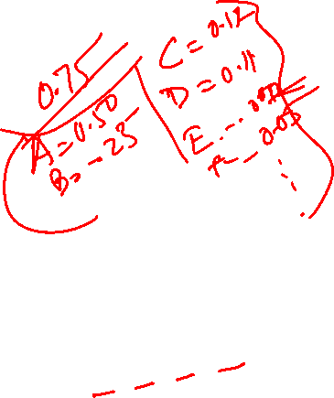
Optimization Techniques
Temperature and other parameters
Temperature
0.2 (Low, focused and predictable)
0.9 (High, more creative and diverse)
Top-p (nucleus sampling): Imagine this as a "variety filter." It helps control how diverse the AI's vocabulary and ideas are in its responses.
Max tokens: This is like setting a word limit. It determines the length of the AI's response.
Frequency penalty: This is like a "repetition discourager." It nudges the AI to avoid using the same words or phrases too often.
Presence penalty: Similar to frequency penalty, but it's more of a "uniqueness encouragement." It pushes the AI to use a wider range of words and ideas.

Slide 72

Optimization Techniques
Content-format integrated optimization (CFPO)
Jointly optimizing both content and formatting yields better outcomes than content-only tweaks
Tested across multiple open source LLMs, demonstrated consistent performance gains through iterative content and format adjustments.
Few‑shot + chain‑of‑thought prompting
Combining few-shot examples with explicit chain-of-thought reasoning markedly improves model performance on reasoning tasks
Metaprompting and LLM‑driven refinement
Metaprompts harness LLMs to suggest prompt improvements
Frameworks that use LLM-generated feedback loops have shown scalable refinement without heavy human input
Liu, Y., Xu, J., Zhang, L. L., Chen, Q., Feng, X., Chen, Y., Guo, Z., Yang, Y., & Cheng, P. (2025, February 6). Beyond prompt content: Enhancing LLM performance via Content-Format Integrated Prompt Optimization (CFPO). arXiv. arXiv:2502.04295. https://arxiv.org/abs/2502.04295

Slide 73
Optimization Techniques
Iterative evaluation and metrics
A data-driven optimization process
Comprising prompt variation, evaluation against metrics (accuracy, relevance) and refinement
Can even be automated through heuristic search
Automated multistep tasks frameworks
Work for complex multistep workflows, frameworks like PROMST (prompt optimization in multistep tasks)
Integrate human feedback and learned scoring to guide prompt improvement across sequential steps—delivering strong gains over static prompts
Cui, W., Zhang, J., Li, Z., Sun, H., Lopez, D., Das, K., Malin, B. A., & Kumar, S. (2025). Automatic prompt optimization via heuristic search: A survey. arXiv. arXiv:2502.18746. https://arxiv.org/abs/2502.18746
Yang, C., Wang, X., Lu, Y., Liu, H., Le, Q. V., Zhou, D., & Chen, X. (2023, September 7). Large Language Models as Optimizers: Optimization by PROmpting (OPRO). arXiv. arXiv:2309.03409. https://arxiv.org/abs/2309.03409

Slide 74
Prompt Optimization: Pitfalls
Small missteps in prompt design can lead to poor model performance
Trying to do too much in one prompt
Overloading a prompt with multiple tasks, tones or instructions confuses the model and often results in fragmented responses
Using inconsistent formatting—changing how examples are presented, mixing instructions with questions or shifting tone—also degrades output quality
Ignoring audience or use-case alignment

Slide 75
Prompt Optimization: Use Cases
Customer support automation
Content generation
Data analysis and reporting
Educational tutoring systems
Enterprise document summarization

Slide 76
Prompt Optimization: Future
Prompt optimization will shift from manual tweaking to automated, model-driven refinement
Reinforcement learning with human feedback (RLHF)
Prompt distillation
Metaprompt evolution
Tighter integration between prompt optimization pipelines and LLMOps platforms
Automating everything from prompt evaluation to real-time tuning across APIs and deployments
Enable dynamic prompt adjustment, context-aware behavior and cost-aware reasoning
Pushing prompts closer to being adaptive, intelligent interfaces rather than static inputs

Slide 77
Thank You!

